Slide 1

MovieMate
Guide: Mr. SP Acharya
PARMAR ABHISHRUT MEHULKUMAR
UID: RU230448

Slide 2
What is MovieMate?
MovieMate suggests movies or shows tailored to a user’s preferences, watch history, and ratings, enhancing content discovery.
It reduces the time spent browsing large catalogs by offering curated recommendations based on individual tastes.
By providing relevant suggestions, it offers a seamless and engaging viewing experience, helping users make quicker decisions.
It helps users discover new genres, movies, and series they may have missed, broadening their entertainment horizons.
The system adapts over time, learning from user interactions and feedback to improve and refine future recommendations.

Slide 3
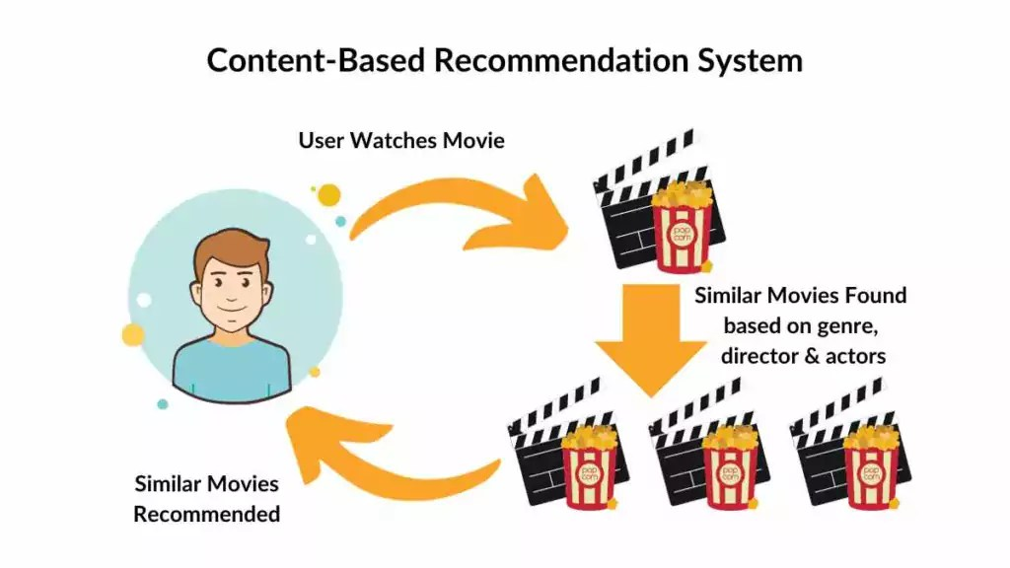
How MovieMate Works:
The MovieMate works basically works on filtering process. There are mainly three types of filtering:
Content Based Filtering : Recommends movies based on the similarity of content features (e.g., genre, actors) to items the user has previously liked. The one we are using

Slide 4
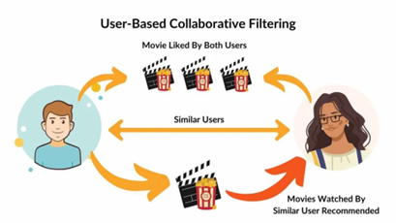
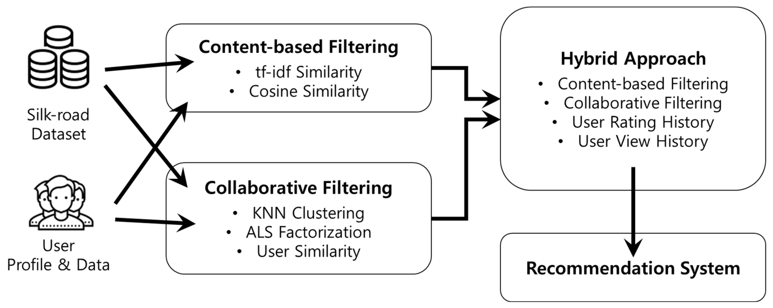
2. Collaborative Filtering*: Suggests movies by analyzing the preferences and behaviors of similar users to find common interests.
3. Hybrid Filtering*: Combines both content-based and collaborative filtering approaches to provide more accurate and personalized recommendations.

Slide 5


Tech STACK
Frontend : React.js Used for creating a dynamic, responsive, and interactive user interface with reusable components for better user experience.
Backend : Node.js with Express.js Handles server-side logic, API routes, and user authentication for smooth communication between the client and server.
Database : MongoDB A NoSQL database to store user data, movie metadata, and user reviews, providing flexibility and scalability.
Machine Learning : Python(Scikit-Learn/NLTK/Flask) Implements machine learning models for content-based and collaborative filtering.

Slide 6




System Architecture
Data Preprocessing
Raw Data
Data can contain various problems which needs to be processed
Creating a ML model to get it ready for work
Website
The desired output to be showed on UI
Model Building
Website

Slide 7
Enhanced Features and Future Implementations
Voice Assistant
Functionality: Allows users to search for movies, control playback, or get recommendations using voice commands.
Technology: Use Web Speech API for browser-based apps or Speech Recognition API in Python for backend processing.
User Experience: Improves accessibility and provides a hands-free, seamless interaction.
Mood-Based Recommendation
Functionality: Recommends movies based on the user’s current mood (e.g., happy, sad, adventurous).
Technology: Utilize NLP and sentiment analysis on user inputs or past review data. Integrate wearable device APIs or facial expression detection (optional) for advanced mood detection.
User Experience: Enhances personalization by aligning content with the user’s emotional state.
These features not only make your system innovative and user-friendly but also stand out in terms of personalization and accessibility.

Slide 8
Expanding Beyond Movies
Books and E-Books:
  Personalized recommendations for novels, self-help, and educational content based on genres, authors, and user preferences.
Podcasts and Audio Content:
  Suggests podcasts and audio shows related to users' favorite topics, aligning with their listening history and interests.
Web Series and TV Shows:
  Recommends binge-worthy series from popular platforms using mood-based and collaborative filtering approaches.
This diversification creates a one-stop content recommendation platform, enriching the user experience across multiple media formats.

Slide 9


